Slide 1
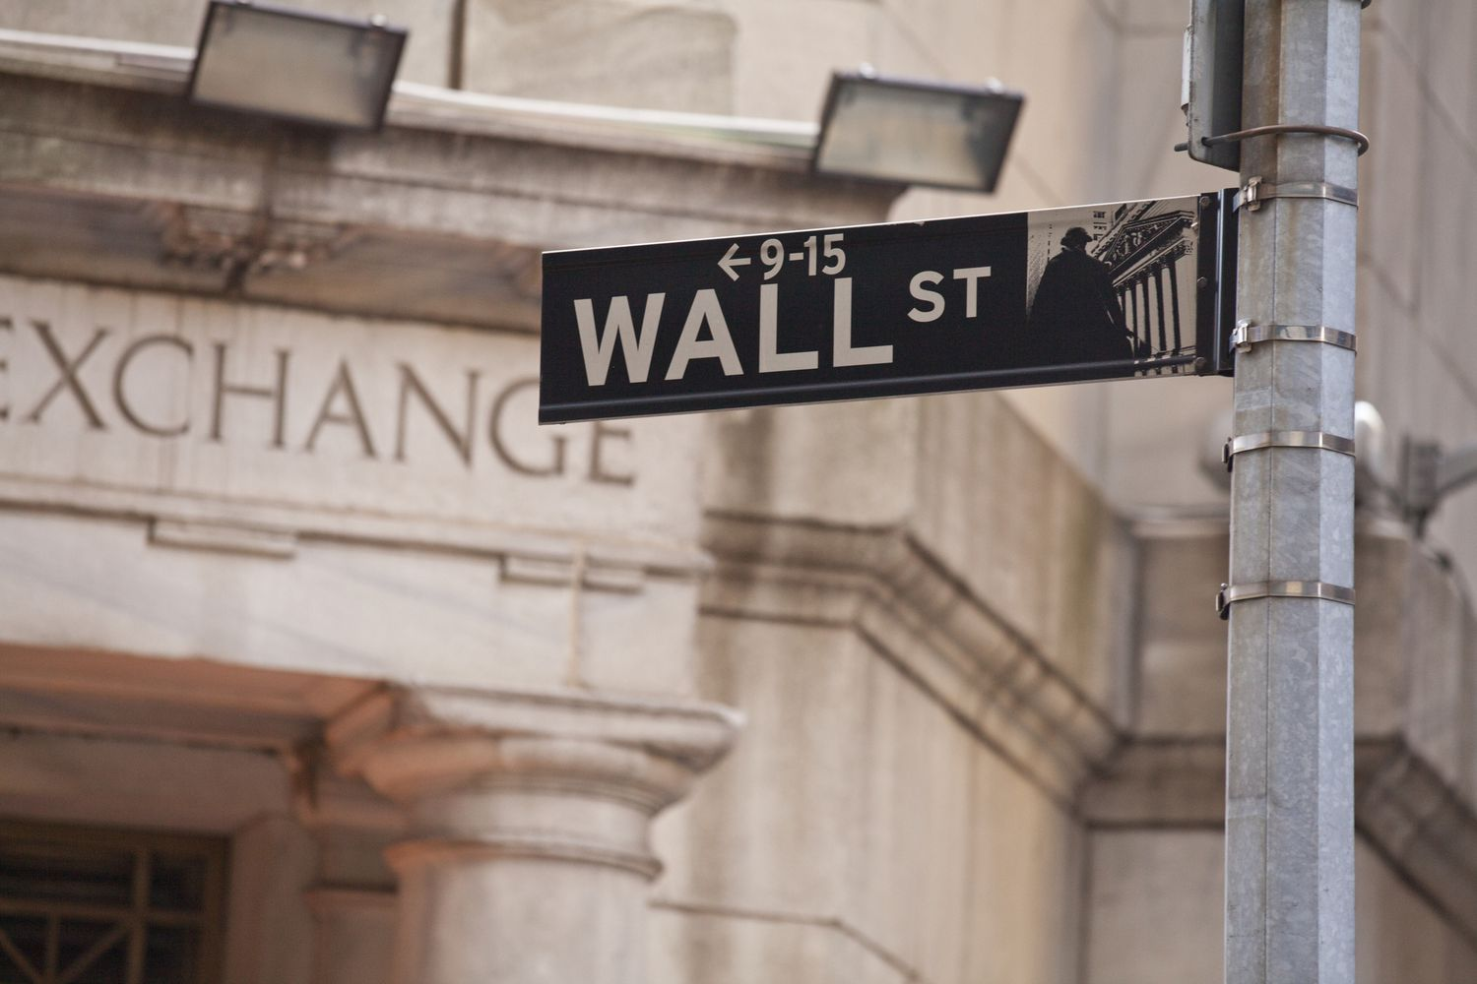
Machine Learning Application to Delta-Gamma Hedging
Machine Learning in Finance

Slide 2


Slide 3


Slide 4




The team
Chady Bensaid
Dorah Borgi
Simon Jonängen
William Olsson
Sara Tegström
Chady Bensaid

Slide 5

Background Recap
Hedging
Sara Tegström
Call options
Right to buy an underlying asset at strike price, after a specified time period
Reducing risk by investing in opposite positions of the asset
Speculation
Put options
Right to sell an underlying asset at strike price, after a specified time period
Betting on an direction of the market or an asset
At the Money
Underlying Asset Price
European options
In the Money
Strike Price
Only possible to utilize the option at maturity
Out of the Money
T=0
Time of maturity

Slide 6
The Greeks
Delta - ∆ [0:1]
Gamma - Γ
Rate of change of option price depending on one unit change of the underlying asset
Rate of change of an options delta
Sara Tegsröm
At the Money
Theta
Underlying Asset Price
Decrease rate of option price as it reaches time to maturity
In the Money
Strike Price
Out of the Money
T=0
Time of maturity

Slide 7
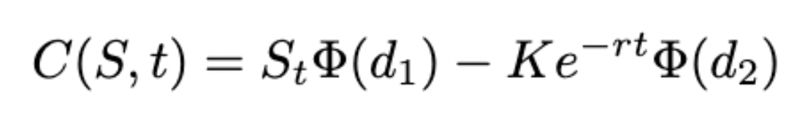
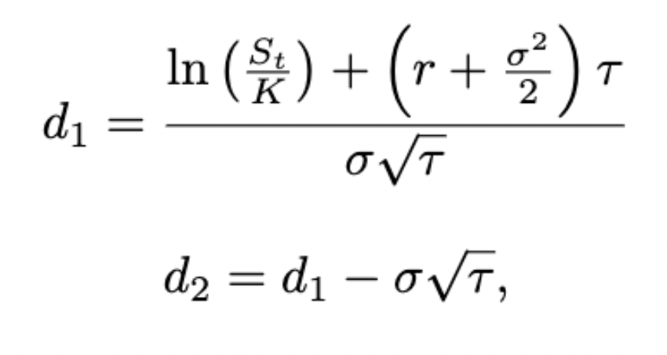
Black-Scholes equation
Pricing model of European options
1973 - Fischer Black and Myron Scholes
Robert C. Merton
Cumulative Distribution
of normal
distribution
Strike Price
William Olsson
Stock Price
Discount factor

Slide 8
Black-Scholes equation
Assumptions
Constant risk-free interest rate
The price of the asset follows a random walk
No dividends
The option is European
Transaction costs do not exist.
Variance is constant
Stock prices are log-distributed.
There are no arbitrage opportunities.
William Olsson

Slide 9
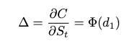
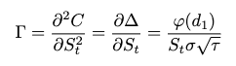
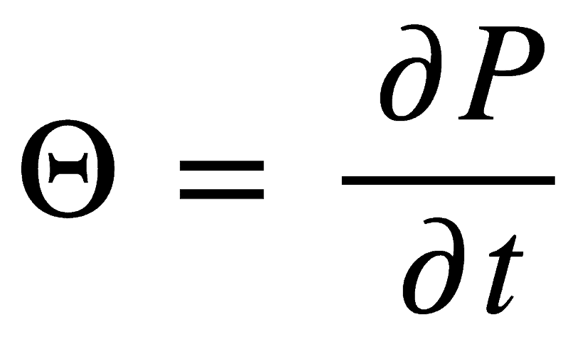
The greeks
Delta - ∆
Gamma - Γ
Rate of change of option price depending on one unit change of the underlying asset
Rate of change of an options delta
William Olsson
Theta
Derivative of gamma
Decrease rate of option price as it reaches time to maturity
Not commonly used, but nontheless can be used as an predictor for gamma

Slide 10
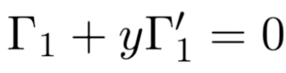
Delta-Gamma Hedging
Delta-neutrality
ensuring that small movements in the underlying asset's price do not affect the overall portfolio value.
Gamma-neutrality
ensuring that the delta does not change significantly with small movements in the underlying asset's price
Cannot achieve gamma = 0 solely through shorting
-- > need another call options
Chady Bensaid

Slide 11
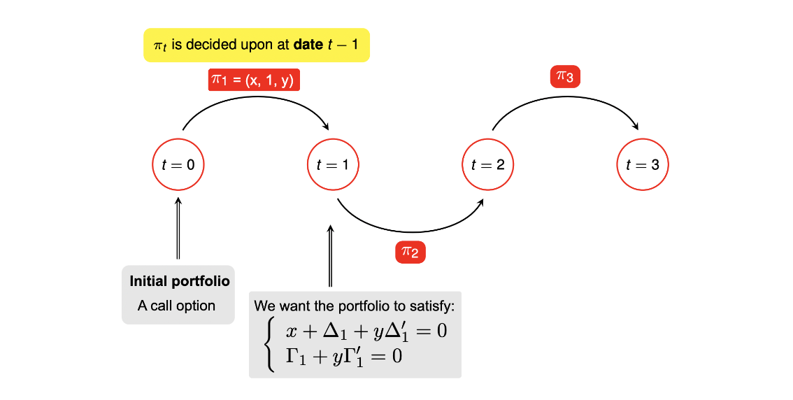
Delta-Gamma Hedging
Chadi Bensaid

Slide 12
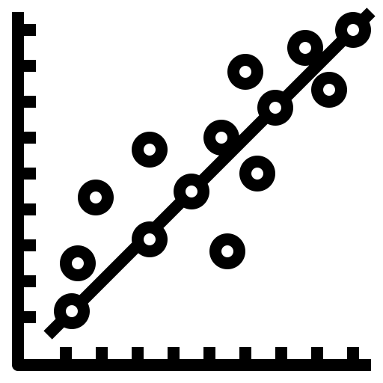
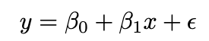
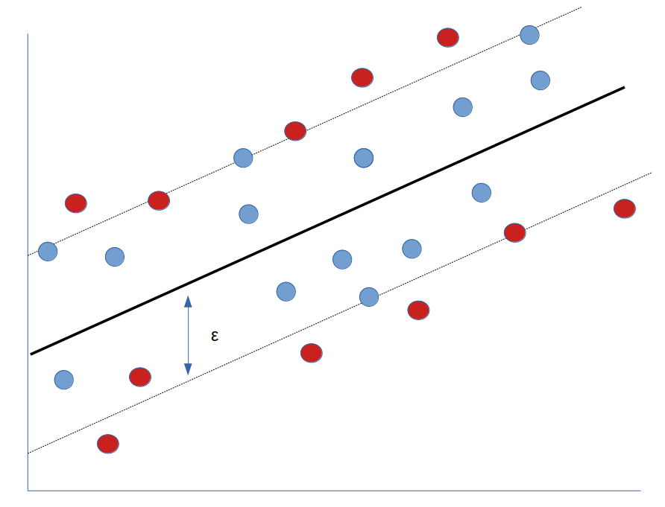
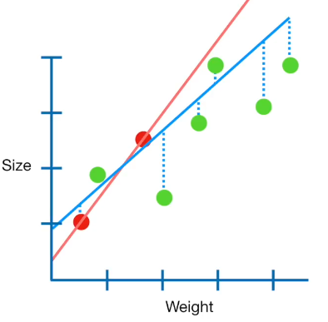
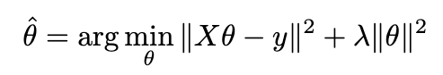
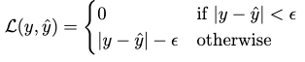
Algorithms used - Regressions
Main tool : linear regression
William Olsson
Support Vector Regression (SVR)
Other possibilities:
Ridge regression if relevant
Kernel trick

Slide 13

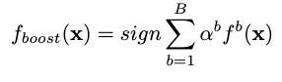
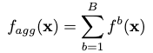
Algorithms used – Ensemble methods
Boosting machines
Bagging
XtremeGradientBoosting
Random forest
William Olsson
B number of weak learners
α - adaptive weights
Overfitting
B number of subsets
Random feature selection
Risk of correlated subsets

Slide 14
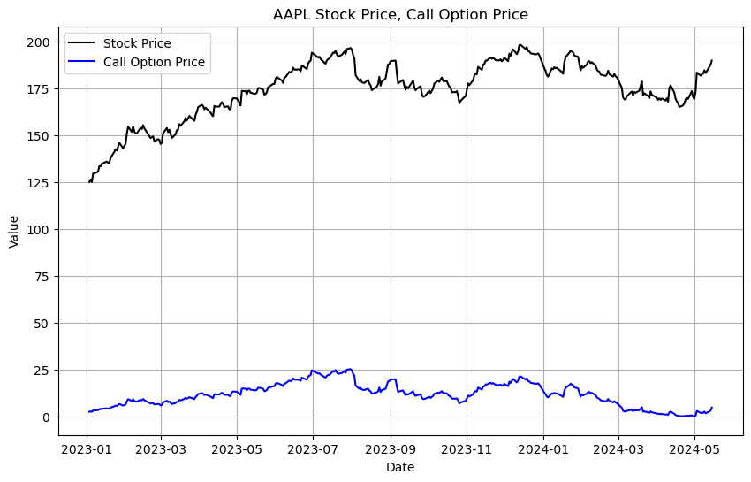
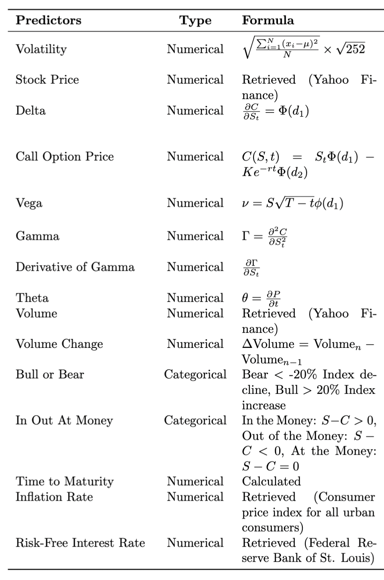
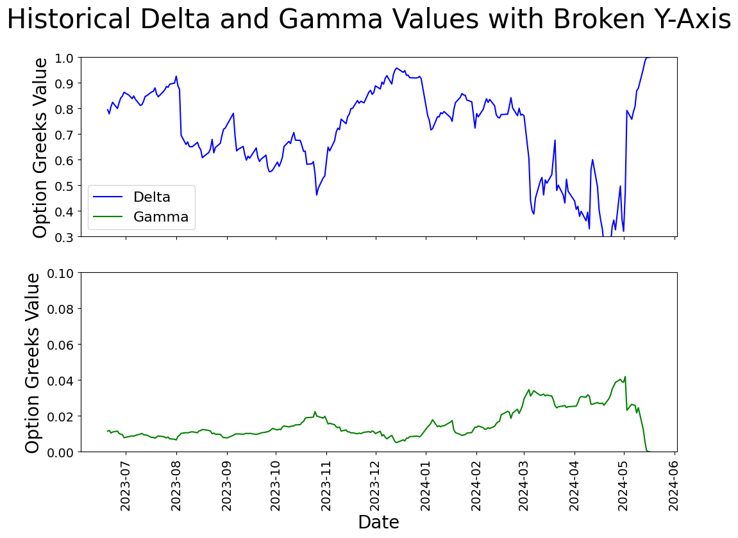
Description of the data
Sara Tegström
+ 2 day lagged variables

Slide 15
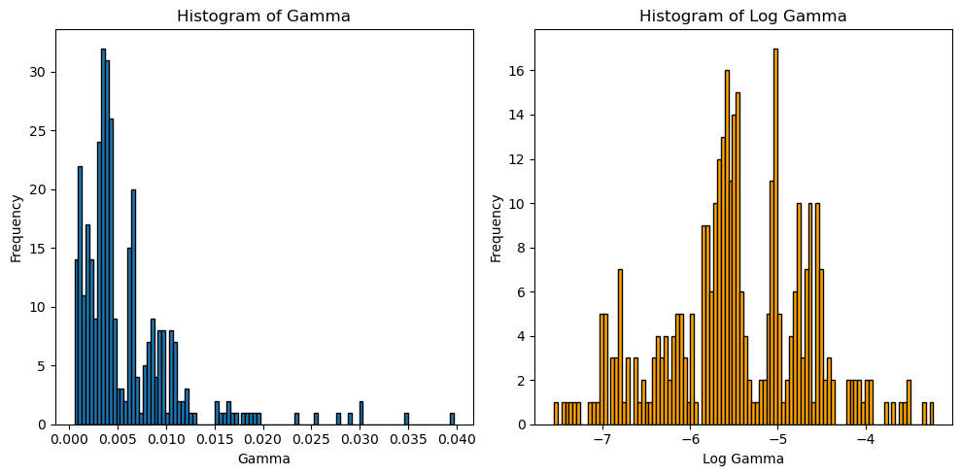
Fixing skewness
William Olsson
Notes:
The left graph displays historical values of gamma which we can clearly see has a right skew of five, which could pose problems. Hence we choose to take the logarithm of gamma, of which you can observe the corresponding graph to the right which significantly improved the skewness.

Slide 16
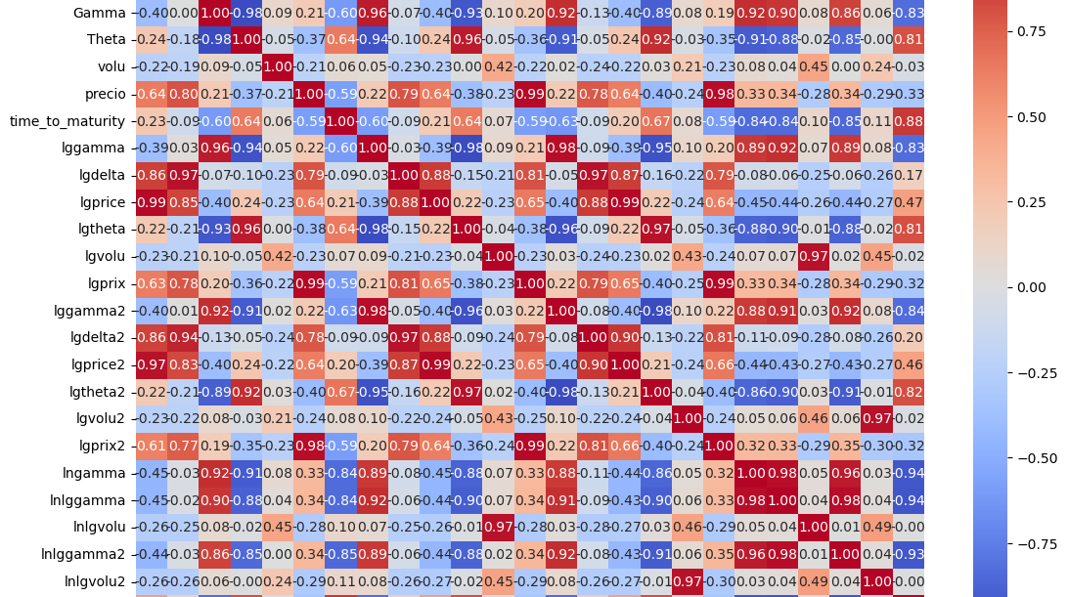
William Olsson
Notes:
We choose to do a confusion matrix in order to get a deeper insight into how the predictors were correlated and non-correlated to each other. As we can observe from the matrix is that gamma is heavily correlated with the price, but does at the same time not seem to be correlated with the volume predictor. Thus it came to decision-making basis for the choice of predictors.

Slide 17
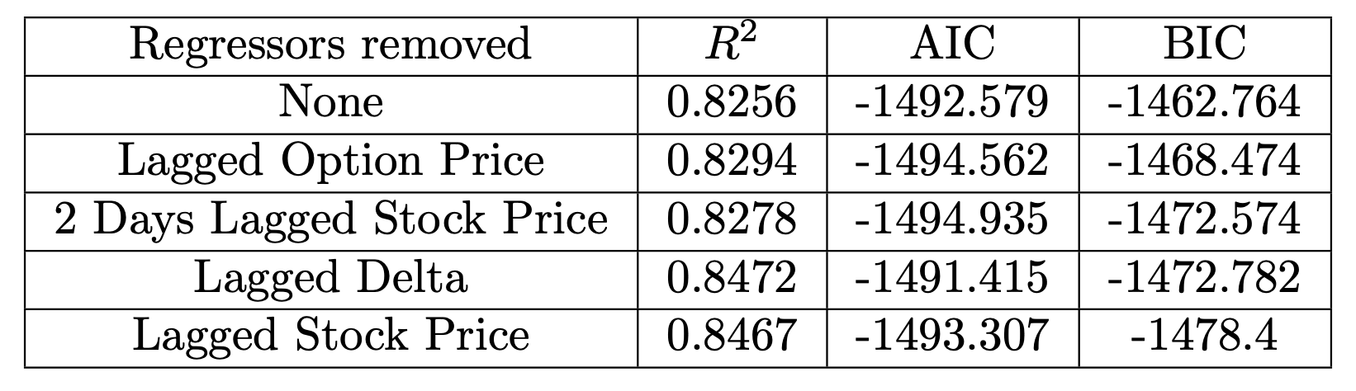
Backward selection
Chady Bensaid
Final model :

Slide 18
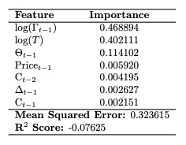
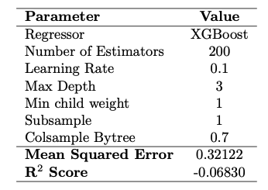
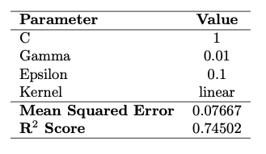
Parameter tuning and performance
SVR
Random Forest
XGBoost
William Olsson

Slide 19
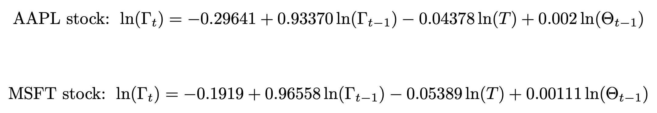
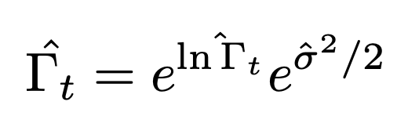
Back to Delta-Gamma hedging
Get prediction for Gamma with
What about the prediction of Delta ?
2 other regressions
Taylor approximations since we have predicted its derivative Gamma

Slide 20
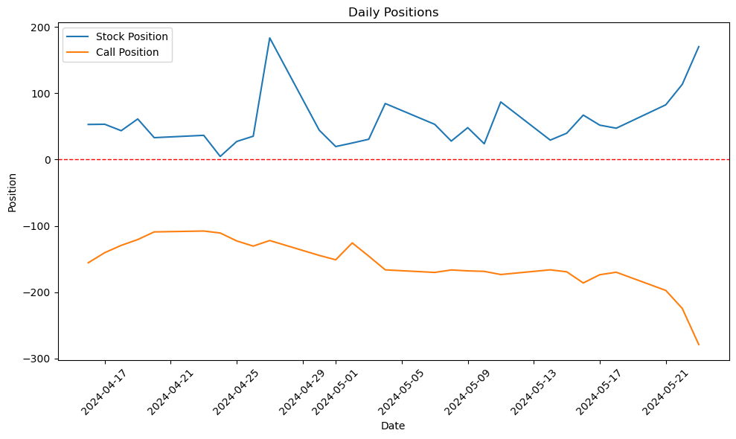
Delta-Gamma hedged portfolio

Slide 21
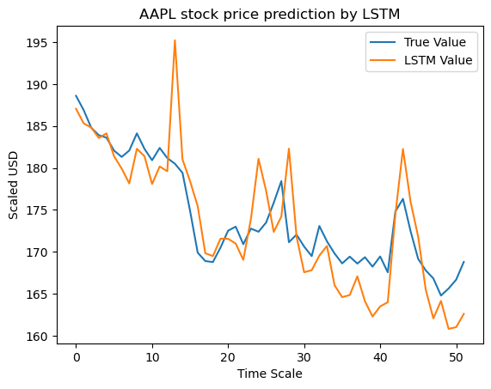
Alternative method
Since the formula for Gamma is known, we can just predict stock price.

Slide 22

End of the story

